Slide 1
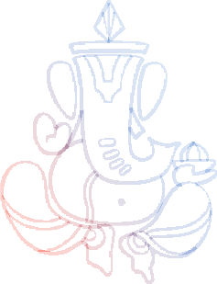
Disha Mukeshbhai Hirapara
Bio-Data
Personal Details
Date Of Birth : 30 April 2000 Height : 5.4"
Weight : 45Kg
Family Background
Father Name :
Mukeshbhai Mulajibhai Hirapara
Mother Name :
Sudhaben Mukeshbhai Hirapara
Elder Sister :
Hemanshi Hirapara (Engaged)
Younger Brother :
Raj Hirapara
Education
MCA
(Atmiya University)
Profession
Web Developer (Happiness Pro Design Studio- Rajkot)
Maternal Details
Uncle Name :
Samjibhai Naranbhai Korat
Place :
Bhadazaliya
Address
Moti Parabadi,Ta:- Dhoraji, Dist:- Rajkot
Contact Details
Mukesh Bhai : 9510900912

